Slide 1
Digdata Step-Up Challenge
Challenge A

Slide 2
Ben and Jerry’s popular choices
Examining the data of reviews the dataset was filtered to only contain prodcuts from Ben and Jerry’s as a attempt to focus on where the brand was suceeding.
Over 400 unique products were listed meaning further processing was required to obtain clearer results.

Slide 3
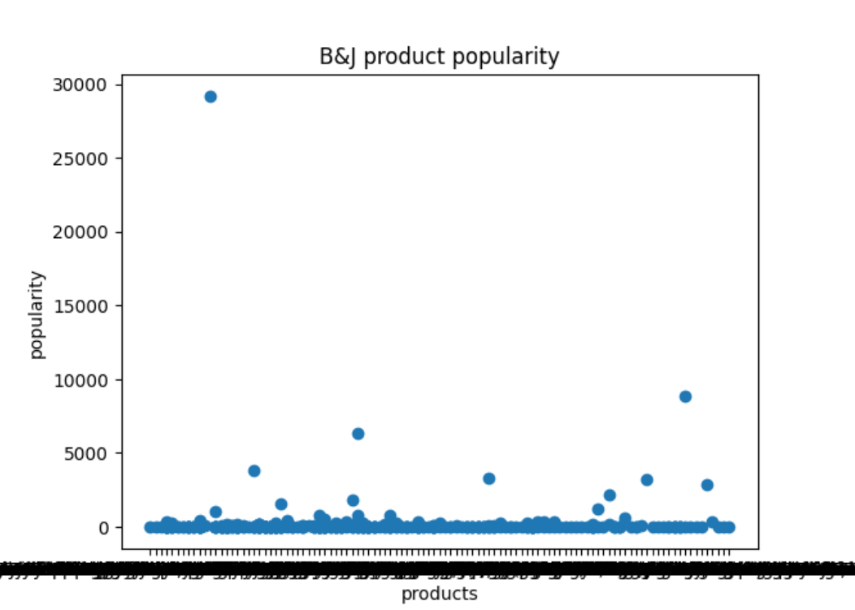
Review-product Score
As multiple review are written per product the popularity of ice cream flavours can be calculated by multiplying the score (stars) of each review by the amount of reviews.
The resultant does not display the information well and needs to be split to separate the high values from the lower ones

Slide 4
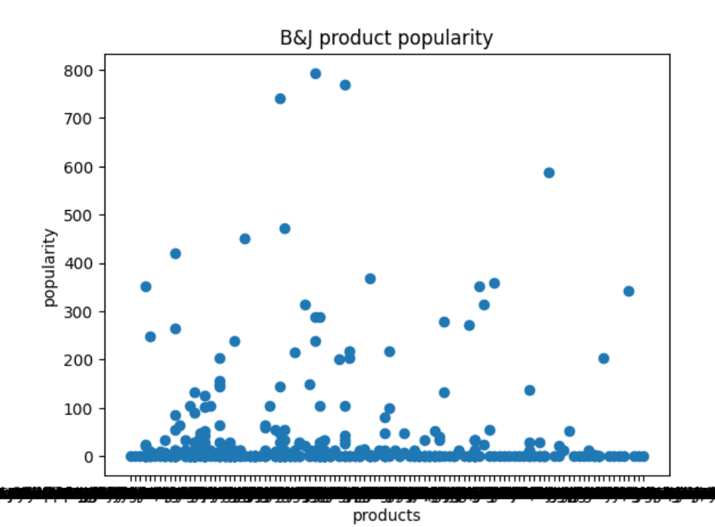
Lower bound values
Out of the 431 product only 419 have a popularity score under 1000
As 800 is the upper limit of the the lower values it can be said that values over 1000 are considered popular and focus should be directed towards those values.

Slide 5
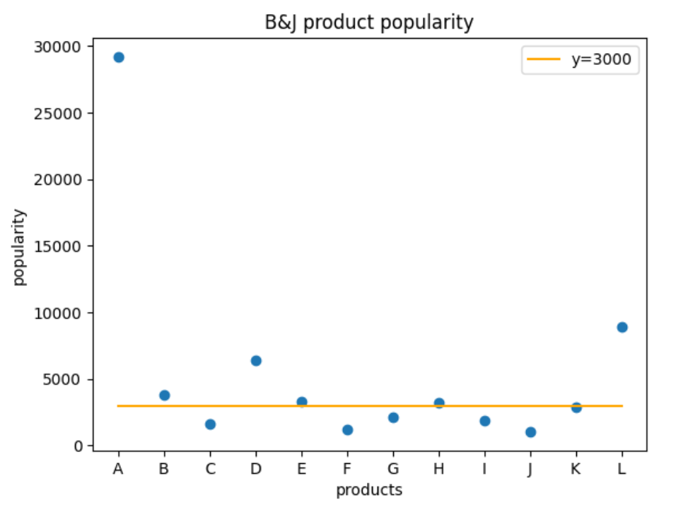
Upper bound data
A: 29200 | Ben & Jerry's Cookie Dough Peace Pop 3 x 80ml, with Fairtrade certified ingredients vanilla Ice Cream Sticks coated in chocolate with a cookie dough centre
B: 3799 | Ben&Jerry's Tony's Dairy Free LoveA-Fair Ice Cream
C: 1596 | Ben & Jerry's Phish Food Ice Cream Tub
D: 6364 | Ben & Jerry's Chocolate Fudge Brownie Ice Cream 465 ml
E: 3306 | Ben & Jerry's Lighten Up Vanilla Brownie Ice Cream Tub
F: 1173 | Ben & Jerry's Moo-phoria Salted Caramel Brownie Light Ice Cream Tub
G: 2134 | Ben & Jerry's Rain-Dough Cookie Dough Twist Ice Cream Dessert 465 ML
H: 3250 | Ben & Jerry's Sundae Oh My Banoffee Pie Ice Cream Tub 427ml
I: 1860 | Ben & Jerry's Sundae Choco-Lotta Cheesecake
J: 1050 | Ben & Jerry's Netflix & Chilll'd Peanut Butter Ice Cream Tub
K: 2900 | Ben & Jerry's Chocolate Fudge Brownie Ice Cream
L: 8888 | Ben & Jerry's Strawberry Cheesecake Ice Cream Tub 465ml, made with Fairtrade certified ingredients, strawberry cheesecake ice cream with strawberries and a cookie swirl frozen dessert

Slide 6
The highest rated flavour is the Cookie Dough with values much higher than all other flavours. The 2nd and 3rd most popular flavours are Chocolate Fudge brownie and Strawberry cheesecake.
While cookie dough has been adapted into a vegan version the other two popular flavours were not found in the dataset. Adapting popular values into speciality flavours would help the sale of these flavours as popular flavours will become available to a wider range of customers.
The vegan cookie dough flavour has a low popularity score of 1, further promotion of this item can support futher sales as a speciality version of the Ben and Jerry’s most popular flavour would be well received.

Slide 7
The 4th most popular flavour is the Ben&Jerry's Tony's Dairy Free LoveA-Fair Ice Cream. As this flavour is a speciality version another strategy can focus on producing unique speciality flavours.
However many other flavours that scored low in popularity can also be considered as unique and therefore it would be expected for unique variants on speciality ice cream to follow suit. This also fails to merge classic flavours with speciality offers as it is considered a unique flavour.
As Tony’s Chocolonely is already a popular brand it is likely that customers familiar with that brand would be likely to purchase the ice cream.
In conclustion, adapting the other two most popular flavours into speciality version would allow more consumers would be the most optimal strategy.

